Slide 1

Exploration activity
Secure data sharing through Contract System and Next Generation Access Control (NGAC)
Ulf Bodin, Eric Chiquito, and Alex Chiquito
Students in D0020E Project in Computer Science

Slide 2
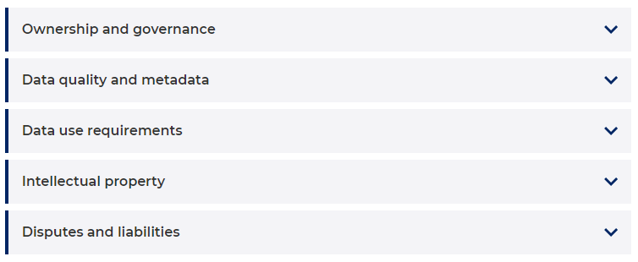
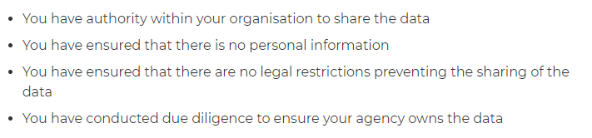
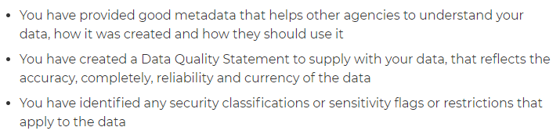
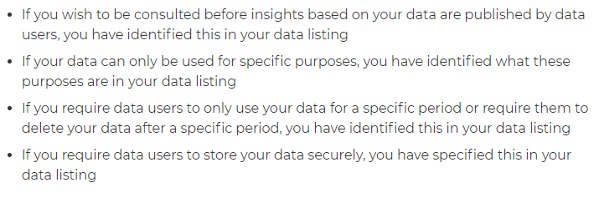
Checklist for data sharing
NSW (New South Wales, Australia)¹:
“To safely share data, you need to answer yes to each of the following criteria.”
“If you answer no to any of the following, complete these requirements before sharing your data.”
Much is matters subject to contractual agreements
¹ Data.NSW, Data Sharing Checklist for Data Owners, URL (visited 20.1.2021): https://devweb.datansw.links.com.au/data-sharing-checklist-data-owners

Slide 3
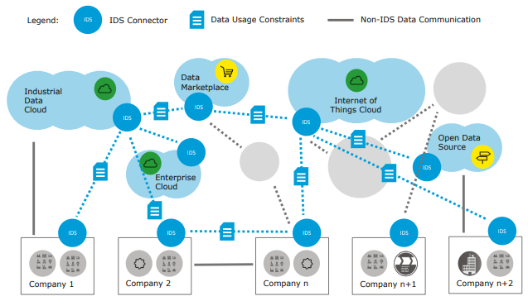

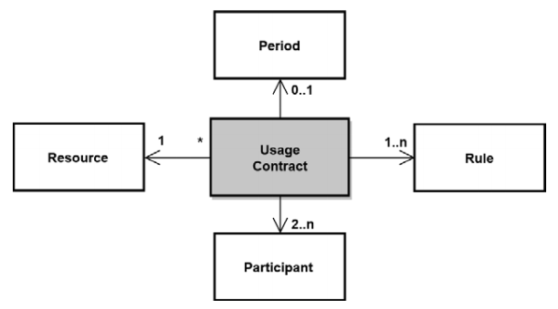
Secure data sharing
International Data Space Association (IDSA) reference architecture¹
Data Usage Constrains
Access and usage control
Usage policies and contracts
¹ IDSA RAM version 3.0, April 2019, URL (visited 28.9.2020): https://www.internationaldataspaces.org/ wp-content/uploads/2019/03/IDS-Reference-Architecture-Model-3.0.pdf

Slide 4
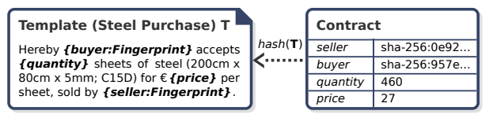
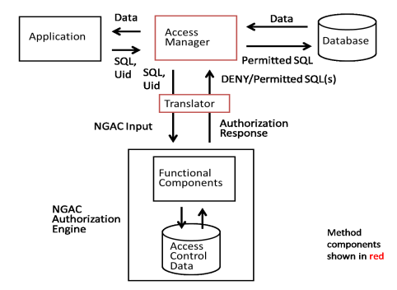








Conceptual approach
Digitized negotiations based on Ricardian contracts
Update access control system based on agreed contracts
Primary / frame agreement
Call-offs / sub agreements
Environmental / context attributes

Slide 5
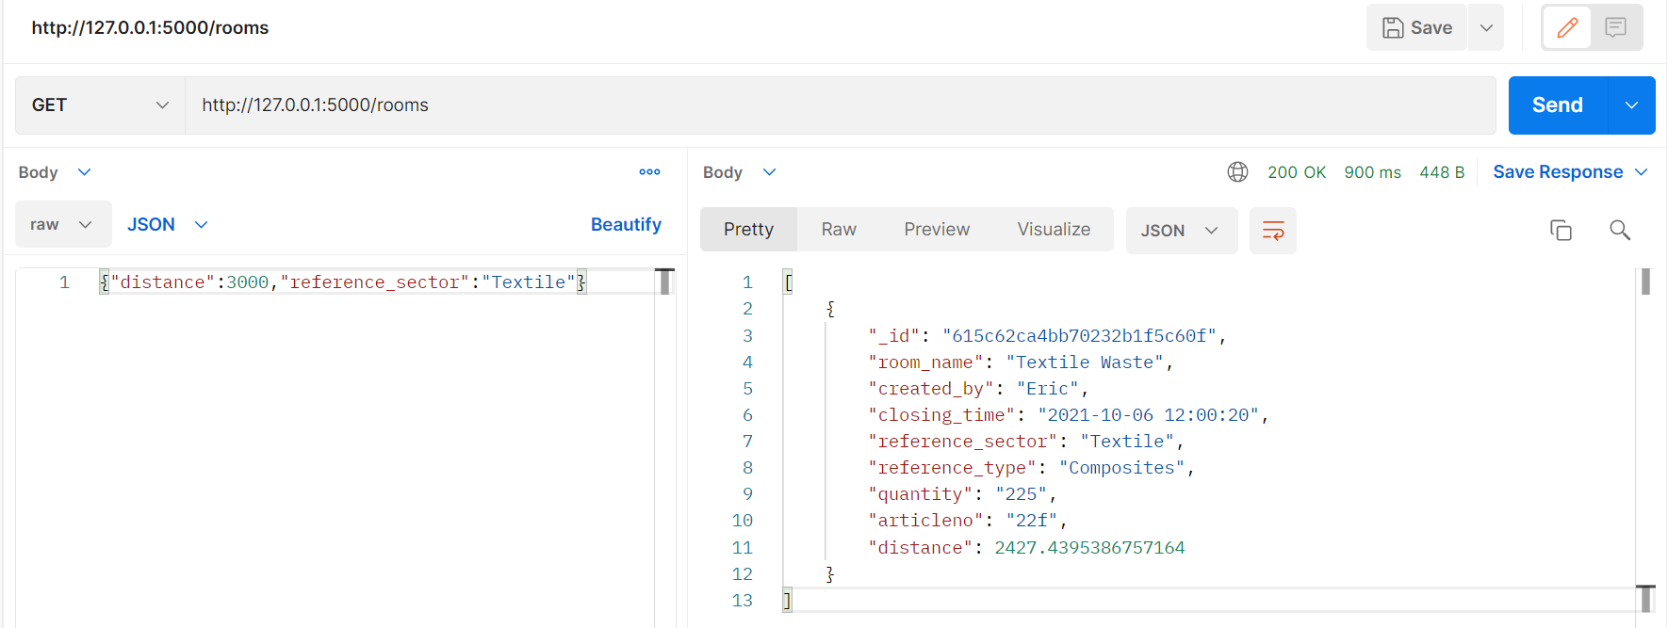
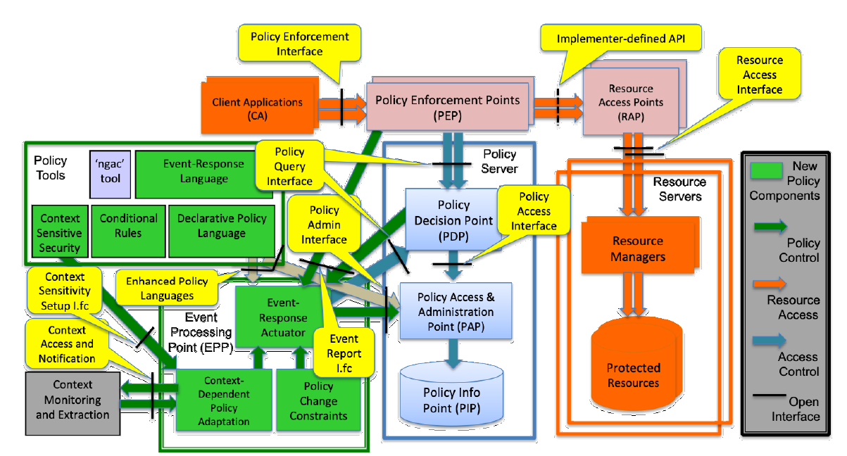
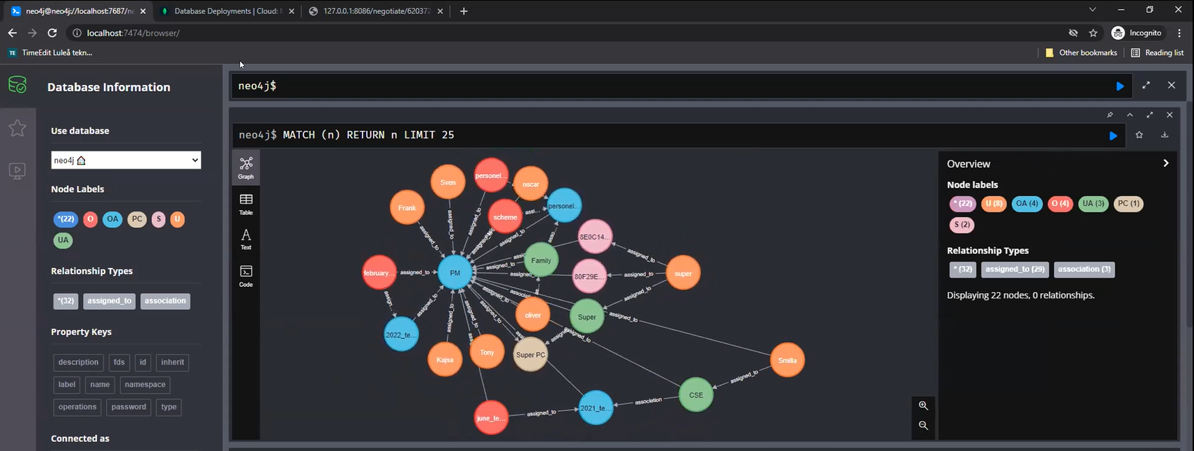
Approach (software used)
LTU Negotiation Engine
https://github.com/EricChiquitoG/NegotiationEngine
Python FLASK implementation for DigiPrime inspired by the Arrowhead ContractProxy system
Implemented as a micro-service with a RestAPI
NIST NGAC library (used via RestAPI)
Resulting policies from contractual negotiation / agreements

